Slide 1
Unit II

Slide 2
The Business Perspective: Business Objectives
So what is the objective of the test?
Why are you considering permitting someone to hack your network?
What do you expect to learn and are you prepared for the results?
Do you have the capabilities to address the identified issues?
The answer to these questions is:
Take security seriously and people who perform ethical hacks will tell you that even the most robust firms fall quickly.
But, is this a reflection of poor security practices, or poor planning of the test?
There are many characteristics of security and how security is realized in a company.
The number of people responsible for security, their practices, and job pressures will have an impact on how the perception of security is materialized in the systems and applications.

Slide 3
Security Policy
At the most fundamental level, a security policy is comprised of collections of statements, with each containing supporting material.
A policy statement generally defines the organization’s stance on a particular aspect of information security.
The supporting material behind a policy statement consists of standards, guidelines, and procedures that outline specific processes to enforce the policy.
Policy Statement. Policy statements should be clear statements on the particular aspect of security that provide no room for interpretation. They should provide generalized, yet pertinent information on what is expected to be practiced within the organization.

Slide 4
Policy statements should avoid justification of the policy, details that are supported by the standards, guidelines, or procedures, or any specific technology associated with the policy. All these characteristics tend to add complexity and open the opportunity to interpretation. Allow the details to be addressed in the supporting statements.
• Standard. A standard is the actual definition of the technical nature of the requirement communicated by the policy statement. Standards provide specific details that explain or quantify the policy statement with which they are associated. Standards should be detailed and clear in communicating the requirements of the policy statement by quantifying the necessary attributes of the policy. However, the standard should not include procedures or step-by-step processes on how to implement the policy. The goal is to define the final structure associated with the statement.

Slide 5
• Guideline. A guideline is a collection of supporting activities to help associate everyday activities with the support of the policy statement. Guidelines provide general suggestions or recommendations that further clarify the policy with general details or suggestions for their implementation. Without guidelines, the policy statement and standard would have little meaningful impact on the typical user. To accomplish this, guidelines should provide associated technologies and guidance in various conditions. However, once again, the processes for carrying out the policy should not be addressed within the guidelines.
• Procedure. A procedure defines the tasks required to meet the requirements set forth in the policy. Procedures are step-by-step instructions detailing how a particular task is to be performed. These are executed to implement and enforce policy statements, or to measure the organization’s compliance with a particular statement for later auditing purposes. Procedures should be very clear on performance of necessary tasks and should avoid any information outside the scope of simply providing the steps to complete and enforce

Slide 6
Previous Test Results
There are many organizations that have tests performed regularly with their own set of results, recommendations, and implemented countermeasures.
The deliverables from a previous test provide the opportunity to plan a new ethical hack in a manner that is complementary to previous investments.
For example, a company may have identified specific vulnerabilities during the previous test resulting in the acceptance of that risk.
To continue testing a risk that has been identified and absorbed into the client’s acknowledged exposure can be a waste of time.
Nevertheless, vulnerabilities change with the ebb and flow of technology. Therefore, assumptions about identified weaknesses should not be made lightly. Finally, and much more common, is that the testing firm can review the previous test results to test the identified vulnerabilities the customer has assumed have been fixed since the last test.
Although this has more of an audit flavor, the services firm can move on to other areas after verifying that the holes were fixed.

Slide 7
Business Challenges
In spite of the risks to achieve business goals companies understand the need to accomplish several fundamentals to ensuring the success for the overall business:
• Meeting financial and business objectives
• Maintaining and increasing corporate brand value and corporate reputation
• Protecting their network infrastructure investment
• Executing and protecting strategic initiatives (mergers, partner alliances, etc.)
• Providing a friendly and secure E-business environment
• Supporting a remote-based employee environment
• Reducing the time to market for providing new services to users and end clients

Slide 8
Planning for a Controlled Attack: Inherent Limitations
Inherent limitations are those restrictions that are associated with paying someone to perform an act normally practiced by criminals from a completely different culture and mindset.
Following are some of the limitations that are intrinsic to the test:
Time. The time a real hacker is afforded to collect information, gather tools, test the waters, get to know people, or any other aspect of hacking that can be used to obtained what is desired is arguably limited to only that person’s life expectancy.
Money. It should not be assumed that hackers don’t have any money. In reality, depending on the role they may play in organized crime, substantial investments may be made in providing them all the necessary tools and technology to perform their deed

Slide 9
Determination. Tenacity can play a significant role in how a hacker approaches a target.
Legal Restrictions. Regardless of a legal documentation put in place to protect the tester from typical activities that under normal circumstances would be considered illegal, a virtual line remains separating the typical attack strategy from an act of terrorism
Ethics. In every professional’s career he is at one point faced with a dilemma that forces a decision based solely on his ethics. It’s safe to say that security consultants have ethics in how they work with clients and others in the industry.

Slide 10
Imposed Limitations
The ability to realize the true value of a penetration test is proportionate to the client’s interpretation of security and how those assumptions are translated into restrictions placed on the test.
Limitations can be introduced by the customer for many reasons that can range from financial restrictions, which force less time and inherently reduce the scope of the engagement, to restrictions based simply on political positioning, personal perspectives on security, or a misguided attempt to focus the test.
Imposed limitations are elements of the test that are not employed for reasons that may not have anything to do with security. I
n fact, one could argue that imposed limitations have nothing to do with security at all and materialize to simply promote control of the engagement.

Slide 11
Timing is Everything
Security is constantly changing within an organization.
Through the adoption and evolution of technology, practices, management, and the perception of security within the company, the security posture of a firm rises and falls frequently.
Many characteristics of security increase, decrease, or simply fluctuate with time.
As one characteristic gets more attention, others are certainly going to wane or grow stagnant

Slide 12
Security is the combination of technology, management, culture, and policy, and it is difficult to do all of them at the same time in the challenging environment of a typical company.
Therefore, elements of security begin to suffer and become fragmented due to the lack of attention and ultimately action by the company.
Where a penetration test is performed, the cycle of security within an organization can affect not only the outcome, but also the value of the test.
It is not only essential to ensure the test is reflective of the threats the client is concerned about, but the extent of the test, and even if the test should be performed, should be weighed heavily

Slide 13
Attack Type
it is possible to reduce their activities into two basic areas that allow us to glean more information about hackers and their targets.
1. Opportunistic. An opportunistic attack is the result of hackers looking for vulnerable systems rather than systems with specific information for the taking.
Usually this is reflected by the plethora of hacks that follow a vulnerability report and the launch of a worm that uses a vulnerability to spread itself and cause trouble.
In all cases, the target was identified after the vulnerability was discovered and then exploited.
Typically, these attacks are preceded by a port scan or some form of discovery process that exposes the vulnerability.
Although this may seem innocuous, many of the hacks on the Internet can be attributed to this type of attack.
Mostly, the result is a denial of service, Web defacement, or temporary loss of data.
What can be disturbing is the number of highly effective attacks that are based on using the initial vulnerability as a beachhead to launch a much more devastating attack

Slide 14
. 2. Targeted. A targeted attack is the assumption that the hacker knows the target and knows what she wants to accomplish.
Although this is based on whether the attacker is looking for any type of vulnerability to gain access, as opposed to looking for a specific vulnerability for any type of company, an arguably indeterminate metric, it does demonstrate the basic approach of a hacker.
Therefore, one would rightly conclude that ethical hacking is a targeted attack type.

Slide 15
Source Point
There are several types of attack that can be employed to help a company determine its exposure. Typically, these are broken into three major areas, each resulting in various conclusions about where the attack is launched.
1. Internet. When you hear the term ethical hacking you immediately picture someone hacking into a network from the Internet.
In most cases, this is a reality.
The Internet is seen as the source for all the pains associated with hackers, even though statistics tell us that equal loss is attributed to internal threats.
Nevertheless, in most penetration-testing engagements, the Internet is the source point of the attack.
This helps an organization determine its exposure to the plethora of attacks represented by an endless sea of threats.

Slide 16
2. Extranet. To function in today’s connected economy, most companies maintain some form of connectivity with partners, suppliers, and customers.
All of these connections are critical to the successful operation of the business and are sometimes overlooked (arguably on purpose) when it comes to security.
However, companies are starting to take a greater interest in the security of their connectivity with their business constituents.
Today more and more companies are performing tests against their once-trusted networks to look for vulnerabilities that may exist between partners or between them and remotely connected networks.
This is also true when attempting to map a network.
On more than one occasion discovery tools are used on these network segments only to find that they can see the entire network of a partner, or even worse, of an old partner that should have been disconnected a long time ago.

Slide 17
3. Intranet. Arguably, one of the more complicated aspects of ethical hacking is the internal hack.
Intranet-based attacks can be difficult to perform given the imposed limitations, but in practice it is like a playground for testers.

Slide 18
Required Knowledge
Usually some form of information is provided by the target and only in the most extreme cases absolutely no information is offered.
Some cannot be avoided, such as the name of the company, whereas others can be easily kept from the testers without totally impeding the mechanics of the test.
Following are some basic definitions of information provisioning:
• Zero Knowledge. Zero knowledge is just that: the tester is provided nothing about the target’s network or environment.
The tester is simply left to his ability to discover information about the client and use it to gain some form of access.
This is also called blackbox or closed depending on who is scoping the test.

Slide 19
• Limited Knowledge. Something growing in popularity with companies seeking penetration testing is providing just enough information to get started. In some cases information may include phone numbers to be tested, IP addresses, domain information, applications, and other data that would take some time to collect and do not represent any difficulty to a hacker, but are rather time consuming for the tester.
The interesting aspect of getting some information and not all is the assumption of scope. Organizations tend to use limited information to define the boundaries of the test as opposed to providing initial data to support the engagement.
For example, there is a difference in providing whether a customer has IDS as opposed to providing a list of phone numbers. The former is an obvious attempt to limit the information provided to the tester, whereas the latter is influencing the scope of the engagement.

Slide 20
• Total Exposure. Total exposure is when every possible piece of information about the environment is provided to the tester.
Prior to the start of the engagement, a list of questions and required items is sent to the customer in preparation for the meeting.
At the meeting, reams of documents are provided to help the tester gain as much knowledge about the network as possible.
This is also known as crystal box, full knowledge, or open, again depending on who is planning the engagement.

Slide 21
Multi-Phased Attacks
The following are the four types of multi phased attacks:
1. Parallel shared
2. Parallel isolated
3. Series shared
4. Series isolated

Slide 22
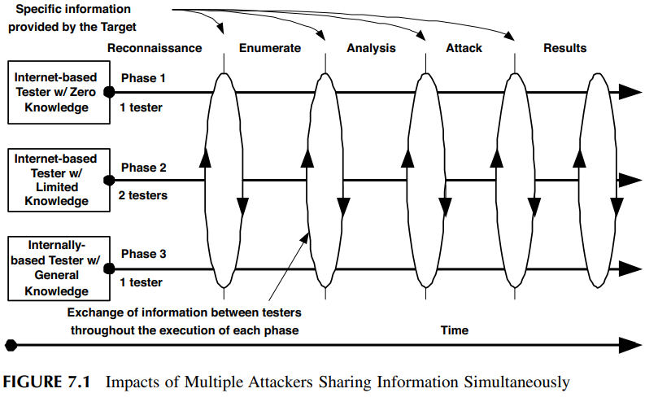
PARALLEL SHARED

Slide 23
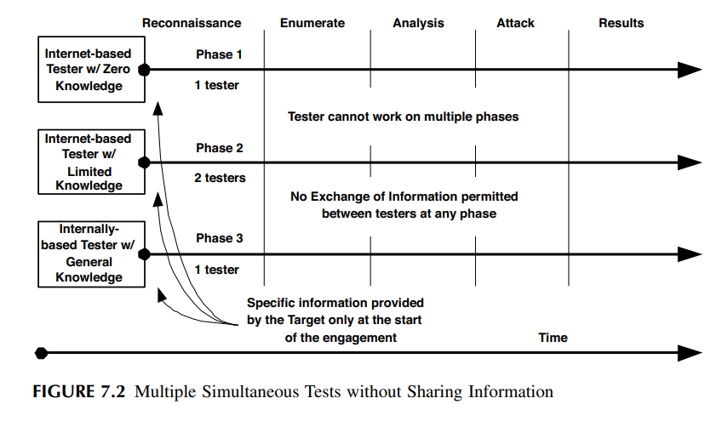
Parallel isolated

Slide 24
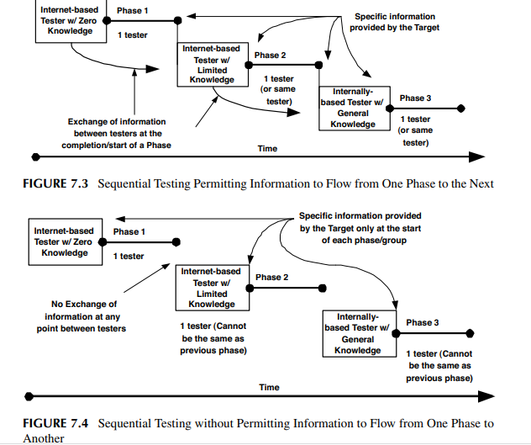
Series shared and Series isolated

Slide 25
Teaming and Attack Structure
No matter the structure of the attack, an operational protocol is crucial to the success of the test.
As with any test there must exist procedures outside the direct experiment to ensure stability, safety, and accuracy of the results.
There are risks that must be planned for to address the uncertainties that lie within the test itself.

Slide 26
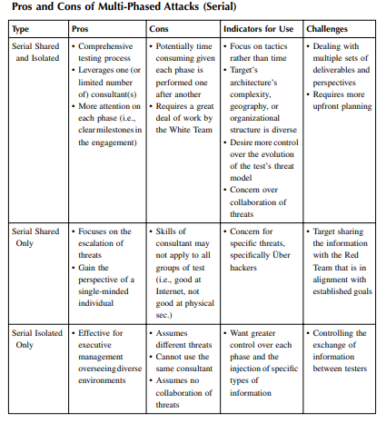

Slide 27
Engagement Planner
A great number of details have been introduced: subjects ranging from multi-phased attacks to information flow from the target to the testers, as well as between the testers on an engagement.
When all these components of the test are considered, the planning of the engagement can become overwhelming.
As stated above, many organizations have an ethical hack performed with very little planning. “Just see how far you can get,” they say.
One of the reasons for basic forms of attack (which ultimately leads to poor value) is that planning an attack can become time consuming and arduous, putting aside the fact that many are not aware of the options available to them.
In an effort to promote comprehensive planning on the part of the company seeking or employing an ethical hack, following are some guidelines and an example engagement planner.

Slide 28
Guidelines: • Perform a self-evaluation of your goals and objectives. Ask yourself what you expect to gain from the test and how you plan to use the results. Are you looking to address specific weaknesses? Or, are you attempting to seek symptoms of a much larger problem within the security program?
• Consider the scope of the attack and what is “in bounds.” Moreover, take the time to evaluate what you have determined is beyond its scope and the potential impact on the objectives. Too much focus of a test is typically the result of budget restrictions or departmental segmentation. With proper planning, both of these areas can be accommodated while still meeting your goals. Of course, too little focus can lead to long engagements that provide little value.
• Ensure all the appropriate people are involved. On paper this appears obvious and simple, but internal politics and departmental rivalries introduce interesting results. There must be an owner, a leader, or primary person that ultimately sets the goals and scope of the engagement. Tests that are planned by committee will typically fail to meet objectives..

Slide 29
• Commit to having a technical expert involved in the process in addition to business managers or executives. All too often, organizations plan and execute attacks without consulting their internal expertise, specifically, security experts. A technical perspective can be very beneficial to outlining the scope and depth of the attack that should be sought to meet executive goals. However, tests that are planned by only technical resources without the dedicated involvement of business management setting loftier goals will certainly affect the potential value of the test.
• During the planning session, ask a lot of questions. However, one must keep an open mind and expect answers that conflict with personal perceptions of security. People typically ask questions they already feel they have an answer for and look to gain the perspective of the interviewee. To ensure the test meets the goals, especially when interviewing a professional organization that performs ethical hacking tests all the time, one must be cognizant of not making any predetermined conclusions

Slide 30
The Right Security Consultant
Information security consultants have experienced an interesting evolution paralleled by the expansion of technology and the proliferation of threats to which companies are regularly exposed.
Security consultants come in many forms with different abilities and conclusions about security.
Much of this is based on their exposure and experience in the security industry and where they have realized successes and failures.
Nevertheless, the skill of security consultants can be categorized in two fundamental camps:
technologists and architects.
In addition, there are many who have mastered both and are highly valued and respected in their industry.

Slide 31
Tester
It is clear that ethical hacking can provide value to the overall assessment of an organization’s security posture and assist in developing solutions that better meet the types of vulnerabilities and threats.
However, there is a trend for enterprises, as well as professional service firms, to hire “reformed” hackers.
This is a likely progression of the philosophy of ethical hacking.
Few understand the idiosyncrasies in performing a comprehensive attack; the processes are difficult to learn, and even harder to practice in the wild, where it matters most.
It is only natural to conclude that an experienced hacker would have the necessary skills for performing hacking services.

Slide 32
Logistics
Planning takes time and effort, but it is well worth it.
So far, we have discussed planning in the form of establishing teams, setting expectations, understanding the ultimate value of the test, and determining the impacts of various restrictions and limitations.
There is another side to planning:
logistics. Logistics are the nuts and bolts of an engagement and are a necessary evil to ensure the total operation is a success.

Slide 33
AGREEMENTS An agreement between the service provider and the customer is a must. Many service provider organizations have a master services agreement that outlines the legal stipulations of the business relationship. These can include warrantees, guarantees, expectations of payment, and other attributes that establish an understanding of the working association. Although usually comprehensive, it is doubtful that standing agreements cover areas directly associated with the risks of hacking a network.

Slide 34
AGREEMENTS An agreement between the service provider and the customer is a must.
Many service provider organizations have a master services agreement that outlines the legal stipulations of the business relationship.
These can include warrantees, guarantees, expectations of payment, and other attributes that establish an understanding of the working association.
Although usually comprehensive, it is doubtful that standing agreements cover areas directly associated with the risks of hacking a network.

Slide 35
Intermediates
During a test, many networks and organizations can be caught in the wake of an attack and possibly be affected by a test to which they did not agree.
Also, given that organizations are focused on security issues more so now than ever before, the test can raise concerns for companies that are between the tester and the target.
It may be necessary to notify the owners of networks that have the potential of being inadvertently included in the attack.

Slide 36
Partners
As networks have evolved, companies have leveraged them to exchange information with other firms to promote more effective business models and growth through alliances.
As with any network, there is an opportunity for the tester to infiltrate the target’s network by using an alternate route provided by a partner network

Slide 37
Customers
Businesses offer a wide range of products and services to customers that may be based on technical integration to provide the product.
Some examples of customer interaction are very similar to the partner communications as detailed above.
In general, businesses supply several different types of network connectivity for their customers, such as frame relay, remote dial-in access, and VPN on a segmented network, much the way they support partners.
Conversely, many companies such as Amazon.com and Yahoo! offer products and services simply over the Internet that are accessed via a traditional Web browser

Slide 38
Service Providers
It is common for a company to use a service provider to support various IT services internally or for external customer support.
Services can range from simple Internet connections and collaboration tools to applications and managed security services.
An ethical hack can have a multitude of problems on these services with varying degrees of impact. Although each one can be addressed specifically, the best method is to establish a basic approach that can be applied to all types of services, if for no other reason than to build a starting point.
This can include:
Communication. Apprise the service provider that the test is being performed and create a communication protocol to support emergencies.
• Details. The source IP addresses of the tester, timing of the test, and what falls within the scope of the test are all important elements to share with any provider.
• Support. More often than not, service providers can help with collecting information about the test. This is especially true with managed security service providers. They can passively collect information about the test and provide a report on activity.

Slide 39
Law Enforcement
law enforcement, specifically the FBI, is getting more and more involved with Internet-related attacks.
Usually, the FBI only becomes involved after the attack to help investigate the crime in support of the victim.
However, more time is being invested by the FBI and other law enforcement agencies in looking for malicious activities on the Internet.
When planning an attack against a company, especially large ones that have historically attracted hackers and may have asked the FBI for support, it is important to make them aware of the test.
Not to do so could jeopardize the engagement or the tester.
This is especially important if there is an ongoing investigation at the target company, or a customer or partner of the company is being investigated.
Notifying law enforcement is not necessary in most engagements, but it should be considered as a gesture of professionalism and awareness that the test could affect others inadvertently involved.

